Slide 1
UMI proofreading and decontamination
Xiang Li
2018.12.28

Slide 2
MALBAC-DT workflow

Slide 3
MALBAC-DT amplification
Reverse transcription
Excess primer digestion
MALBAC-DT amplification (11 quasi-linear + 18 exponential PCR)
Adding outer barcode (5 exponential PCR)
3’AAAAAAAAAAAANNNNNNNNNNNNNNNNNNN5’
5’[MALBAC Primer][RT3][Inner barcode][UMI]TTTTTTTTTTTTNNNNNNNNNNN
[MALBAC Primer][RT3][Inner barcode][HBDV]₅TTTTTTTTTTTT
Primer A
[MALBAC Primer][RT3][Inner barcode][VDBH]₅TTTTTTTTTTTT
Primer B
5’[MALBAC Primer][P7-R2SP][Outer barcode][RT3][Inner barcode][UMI]TTTTTTTNNNNNNNNNNN [MALBAC Primer]3’
3’[MALBAC Primer][P7-R2SP][Outer barcode][RT3][Inner barcode][UMI]AAAAAAANNNNNNNNNNN [MALBAC Primer]5’
From Wenping Ma

Slide 4
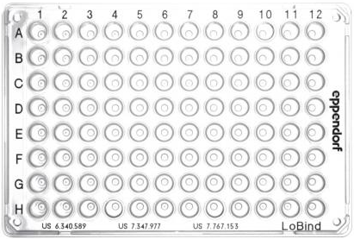
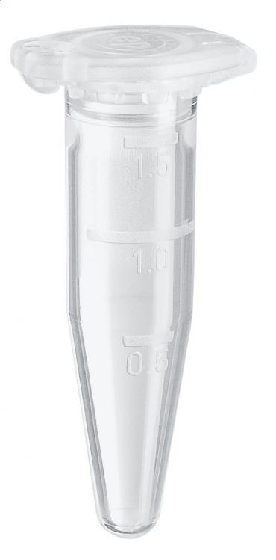
MALBAC-DT library preparation
Sample pool
Vazyme-Nextera like library preparation
One plate pooling to one tube
From Wenping Ma

Slide 5
UMI proofreading

Slide 6
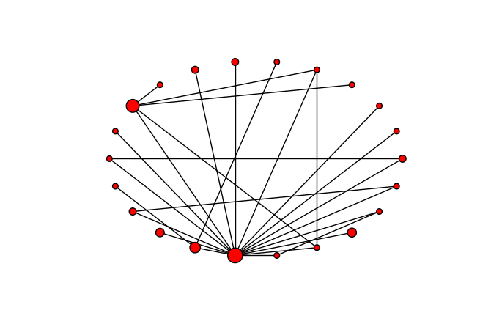
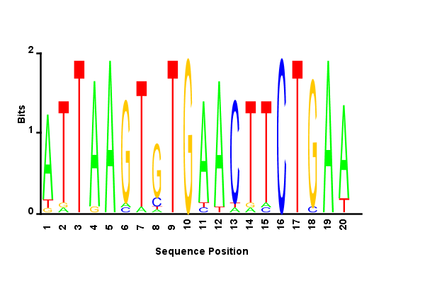
PCR error in UMI
ATTAAGTGTGAACTTCTGAA 137
ATTAAGTCTGAACTTCTGAA 40
ATTAAGTGTGAACTTCTGAT 11
ATTAAGTGTGTACTTCTGAA 5
ATTAAATGTGAACTTCTGAA 4
ATTAAGTGTGAACATCTGAA 2
ATTAAGTGTGATCTTCTGAA 2
ATTAAGTGTGAATTTCTGAA 2
ATTGAGTGTGAACTTCTGAA 2
ATTAAGTGTGAACTCCTGAA 1
ATTAAGTCTGCACTTCTGAA 1
ATTAAGTGTGAACTTCTCAA 1
ATTAAGTGTGAAATTCTGAA 1
TTTAAGTCTGAACTTCTGAA 1
GTTAAGTGTGAACTTCTGAA 1
ATTAAGTGTGAACGTCTGAA 1
AGTAAGTGTGAACTTCTGAA 1
ATTAAGTTTGAACTTCTGAA 1
AATAAGTGTGAACTTCTGAA 1
ATTAAGTATGAACTTCTGAA 1
ATTAACTGTGAACTTCTGAT 1
TTTAAGTGTGAACTTCTGAT 1

Slide 7
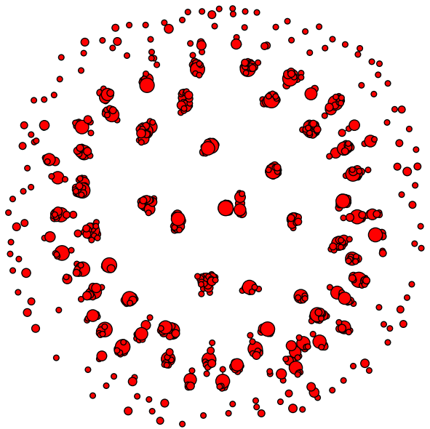
Determine major UMI
UMI graph
For each connected component
Most frequently appear.
Most central.
Most consistent with [HBDV]*5.

Slide 8
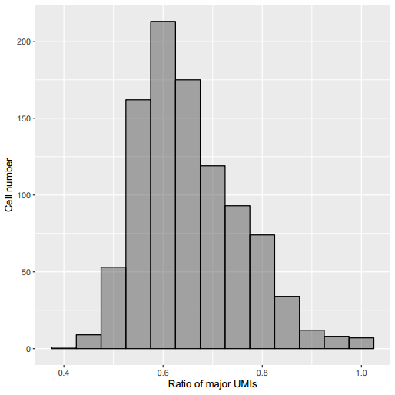
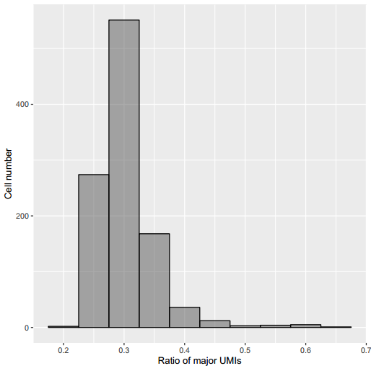
Major UMI ratio in different cell-types
HEK293T
B cell

Slide 9
UMI contamination

Slide 10
Intracellular contamination
Each cell of a cell-line may have ~10^5 major UMIs.
Sometimes a UMI may be discovered in more than one genes.
Significant frequency difference.
In many cases a UMI may be discovered among homolog genes.
Decontamination by UMI frequency.
INTS13 TTTCTTGGTGTATTTCATGC 1
TOP2B TTTCTTGGTGTATTTCATGC 1
PASK TTTCTTGGTGTATTTCATGC 1
ODC1 TTTCTTGGTGTATTTCATGC 1
CCT5 TTTCTTGGTGTATTTCATGC 1
MRPL39 TTTCTTGGTGTATTTCATGC 1
TMEM69 TTTCTTGGTGTATTTCATGC 1041
SEPHS2 TTTCTTGGTGTATTTCATGC 1
VDAC1 TTTCTTGGTGTATTTCATGC 1
LSM14A TTTCTTGGTGTATTTCATGC 1
MTRNR2L12 MT-RNR2
ANKRD36 ANKRD36B
RPL3P4 RPL3P9
MTCO1P12 MT-CO1 MTCO1P40
RPL3 RPL3P4
RPL13A RPL13AP25 RPL13AP5
EIF2S2P2 EIF2S2 EIF2S2P4

Slide 11
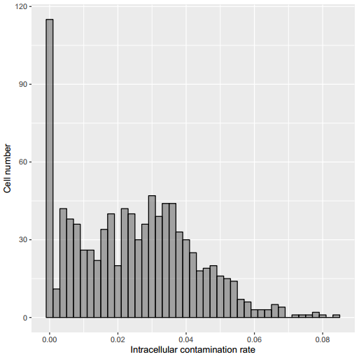
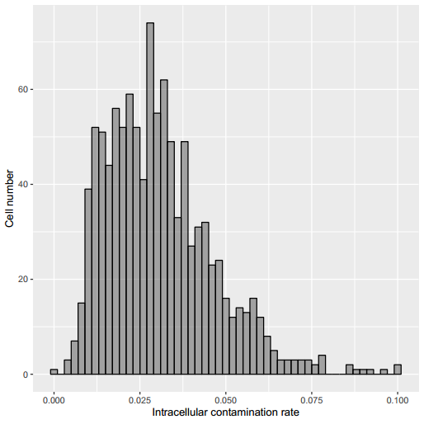
Intracellular contamination rate in different cell-types
HEK293T
B cell

Slide 12
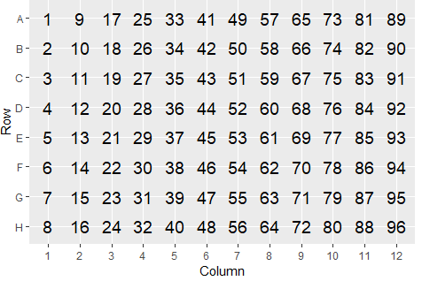
Intercellular contamination
Different cells may contain same UMI in the same gene, sometimes in different genes.
Mainly happen among the cells in the same row.
Sometimes happen among the cells in the same column.
Significant frequency difference.
{'CSDE1': {1: 684, 9: 1, 17: 1, 81: 1} 'TCF3': {57: 1}}
{'CSDE1': {1: 267, 9: 1, 17: 1, 73: 1} 'UFD1L': {81: 8}}
{'CSDE1': {1: 1, 25: 1, 41: 305, 73: 1} 'CENPE': {17: 3}}
{'PGM3': {1: 1} 'DOPEY1': {65: 11}}
{'CCDC88C': {1: 1} 'CCT3': {15: 119, 63: 1}}
{'PSMA4': {1: 22} MT-RNR2 ': {75: 1, 79: 55}}
{'INPP4A': {1: 26} 'PPP1CC': {11: 21} 'PTGES3': {89: 4}}

Slide 13
Intercellular decontamination
Step 1. For each gene contains same UMI, select the most frequent cell, and regard other cells as contaminated.
Step 2. Among different genes contain same UMI, select the most frequent cell among cells belong to the same row.
{'CSDE1': {1: 684, 9: 1, 17: 1, 81: 1} 'TCF3': {57: 1}}
→{'CSDE1': {1: 684} 'TCF3': {57: 1}}
→{'CSDE1': {1: 684}}
{'INPP4A': {1: 26} 'PPP1CC': {11: 21} 'PTGES3': {89: 4}}
→{'INPP4A': {1: 26} 'PPP1CC': {11: 21}}

Slide 14
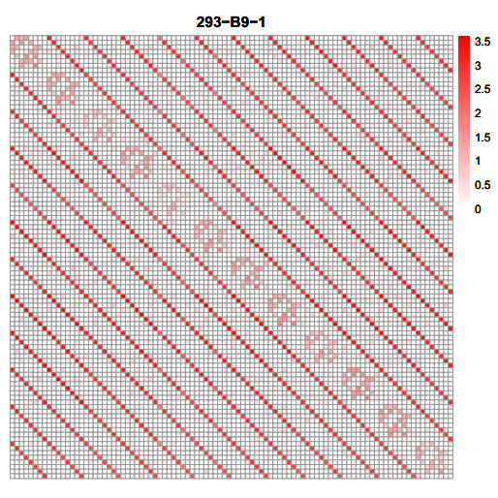
Intercellular contamination pattern
(i,j) = log10 (number of cell i UMIs contaminated by cell j)

Slide 15
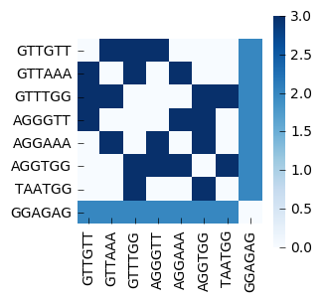
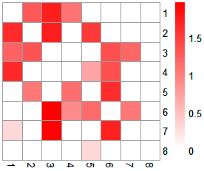
Intercellular contamination among a column
Contamination pattern among column
Row barcode similarity

Slide 16
Possible mechanism: incomplete PCR?
5’[MALBAC Primer][P7-R2SP][Outer barcode1][RT3][Inner barcodeA][UMI]TTTTTTTNNNNNNNNNNN 3’
5’[MALBAC Primer][P7-R2SP][Outer barcode1][RT3][Inner barcodeA] 3’
+
3’[MALBAC Primer][P7-R2SP][Outer barcode2][RT3][Inner barcodeA][UMI]AAAAAAANNNNNNNNNNN 5’
3’[MALBAC Primer][P7-R2SP][Outer barcode1][RT3][Inner barcodeB][UMI]AAAAAAANNNNNNNNNNN 5’
5’[MALBAC Primer][P7-R2SP][Outer barcode1][RT3][Inner barcodeA][UMI]TTTTTTTNNNNNNNNNNN 3’
3’[MALBAC Primer][P7-R2SP][Outer barcode2][RT3][Inner barcodeA][UMI]AAAAAAANNNNNNNNNNN 5’
5’[MALBAC Primer][P7-R2SP][Outer barcode1][RT3][Inner barcodeA][UMI]TTTTTTTNNNNNNNNNNN 3’
3’[MALBAC Primer][P7-R2SP][Outer barcode1][RT3][Inner barcodeB][UMI]AAAAAAANNNNNNNNNNN 5’

Slide 17
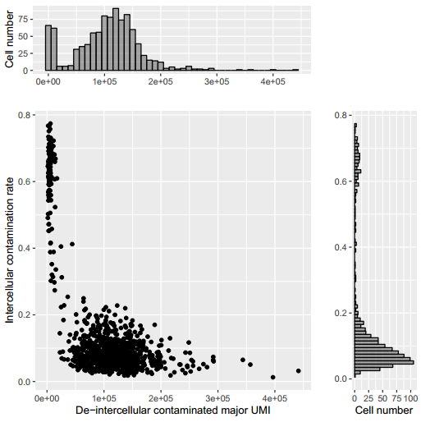
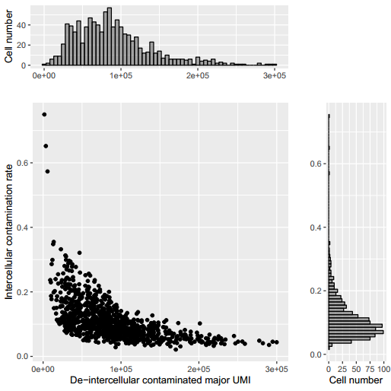
Intercellular contamination rate in different cell-types
HEK293T
GM12878

Slide 18
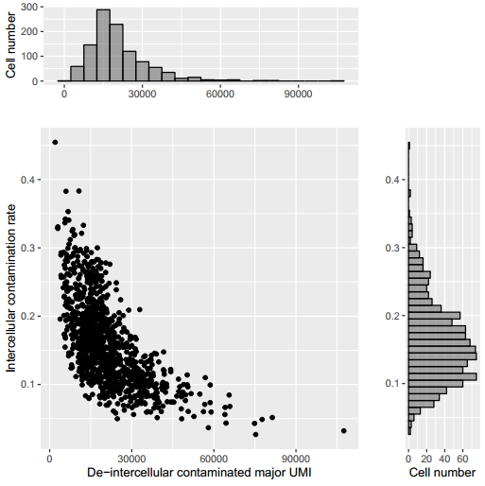
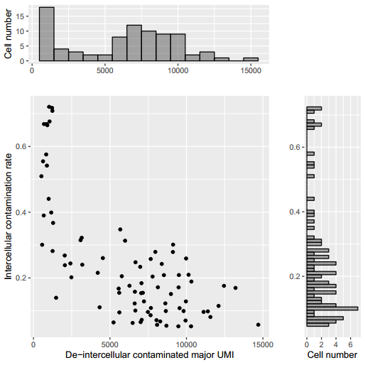
Intercellular contamination rate in different cell-types
B cell
Upper segment of small intestine

Slide 19
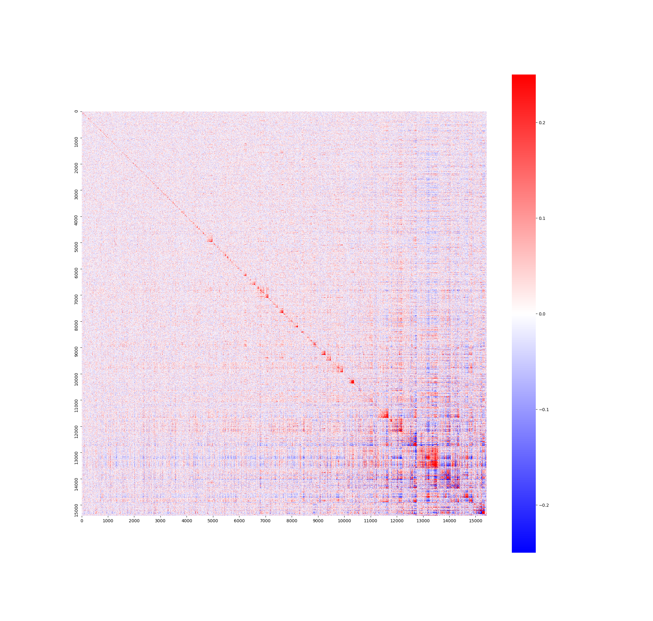
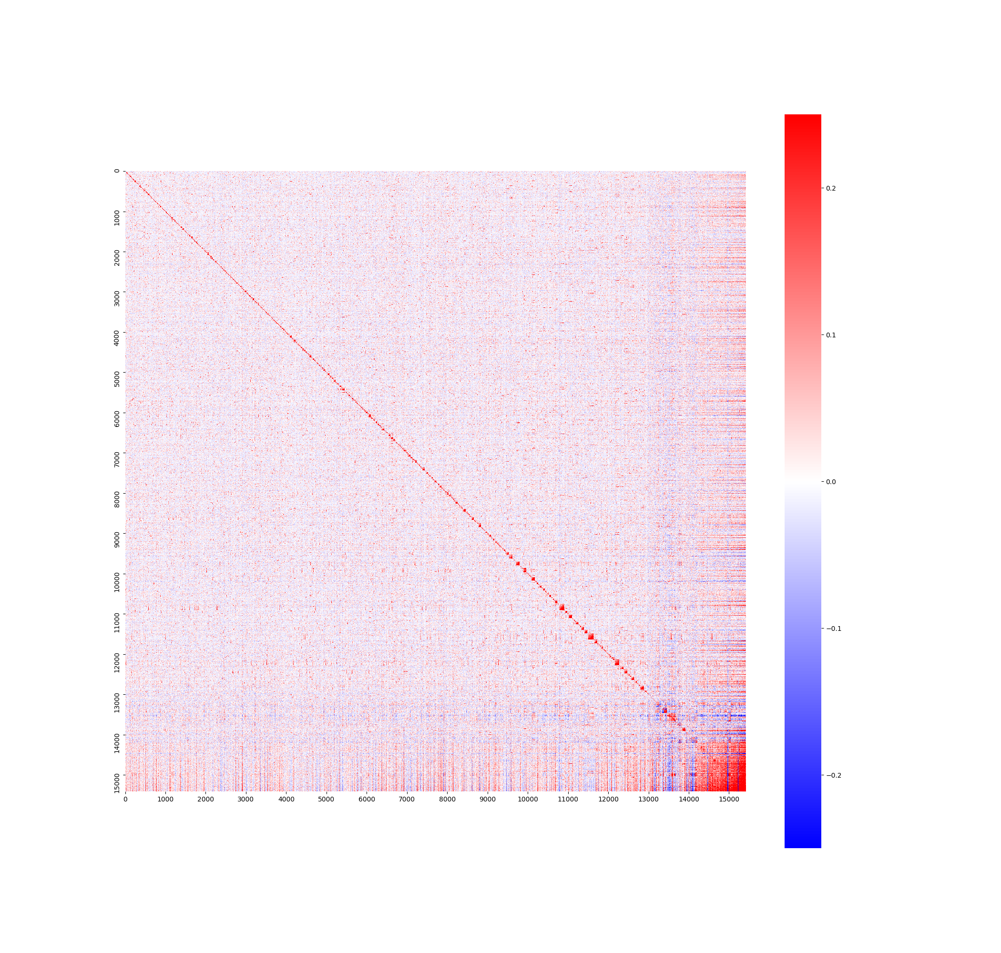
Contamination effect on gene correlation
HEK293T
Contaminated
Decontaminated

Slide 20
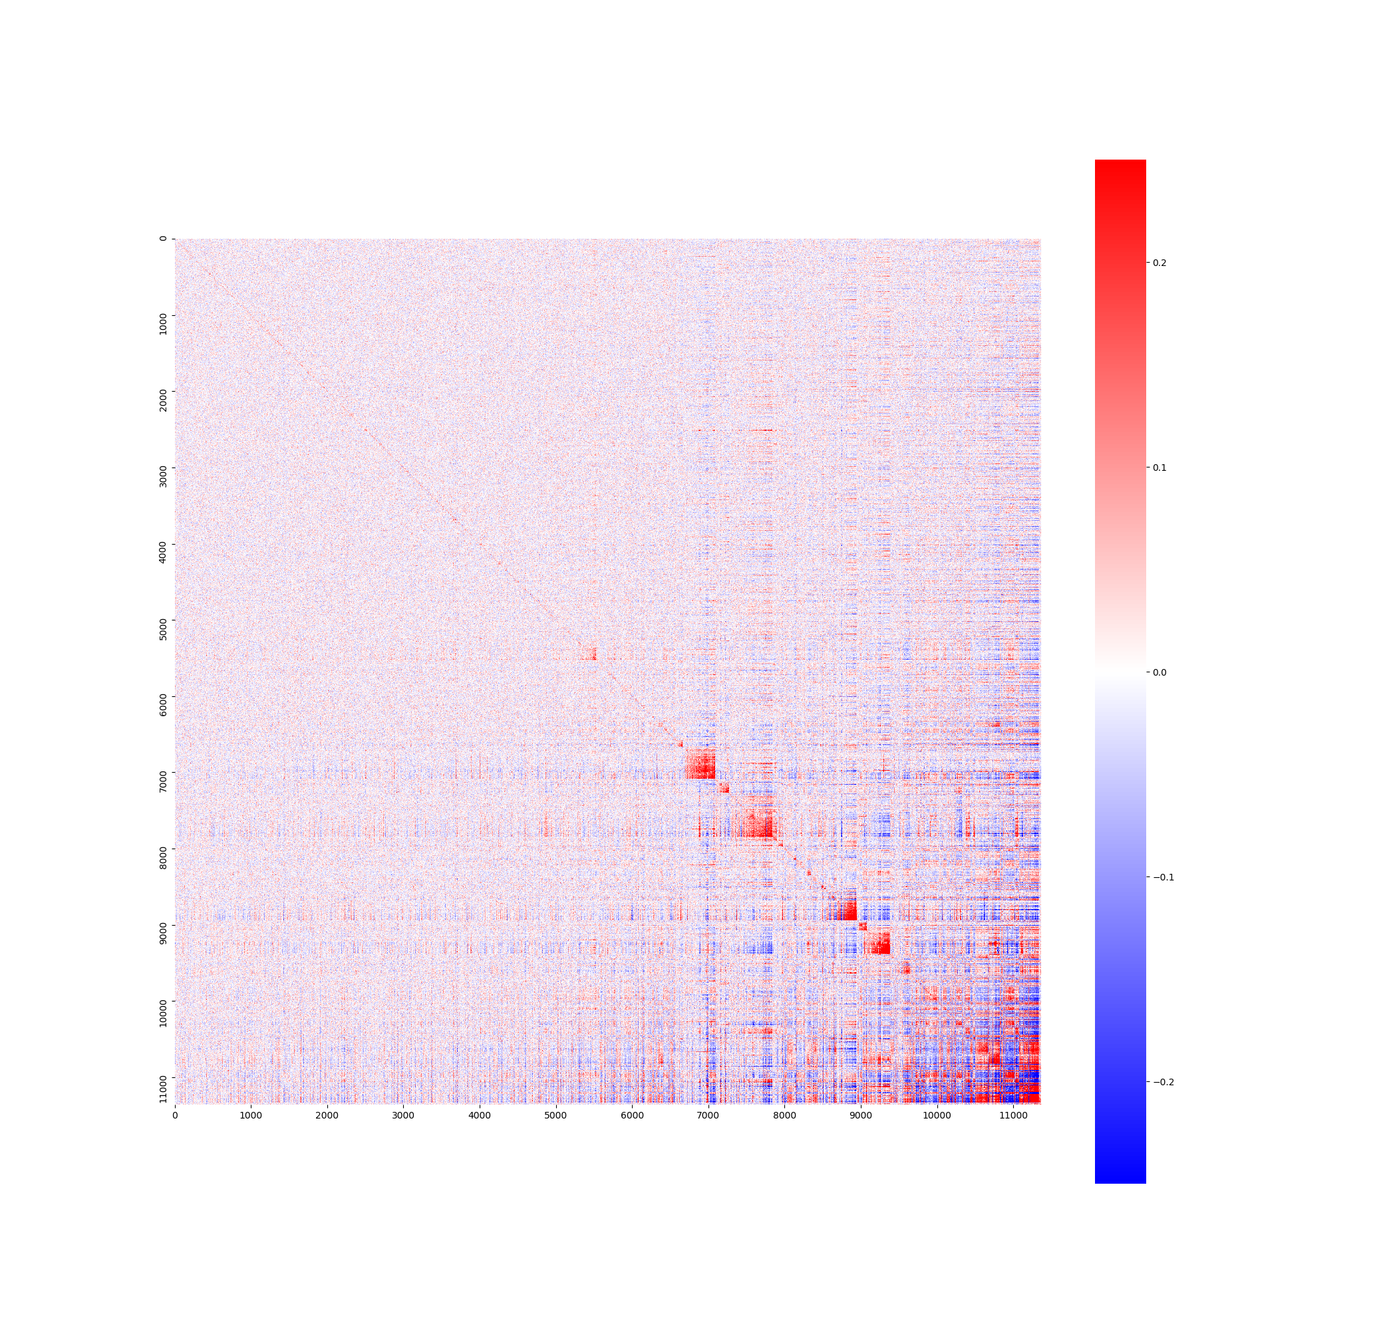
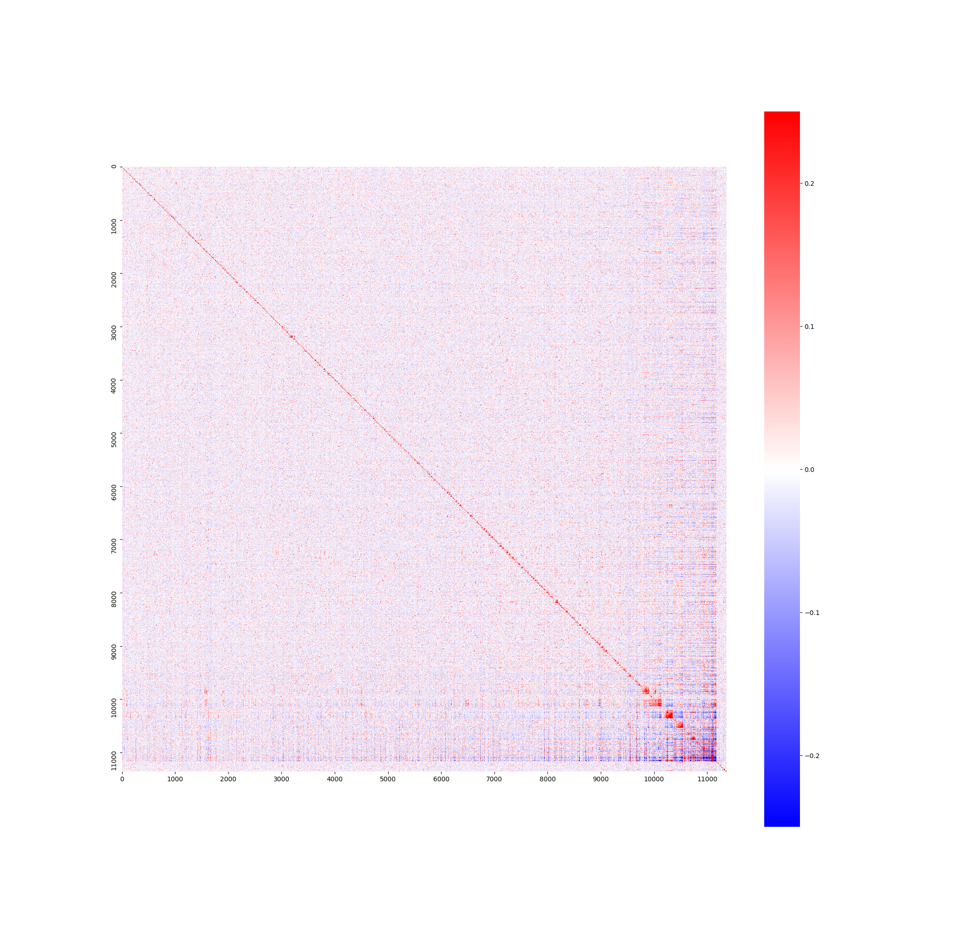
Contamination effect on gene correlation
GM12878
Contaminated
Decontaminated

Slide 21
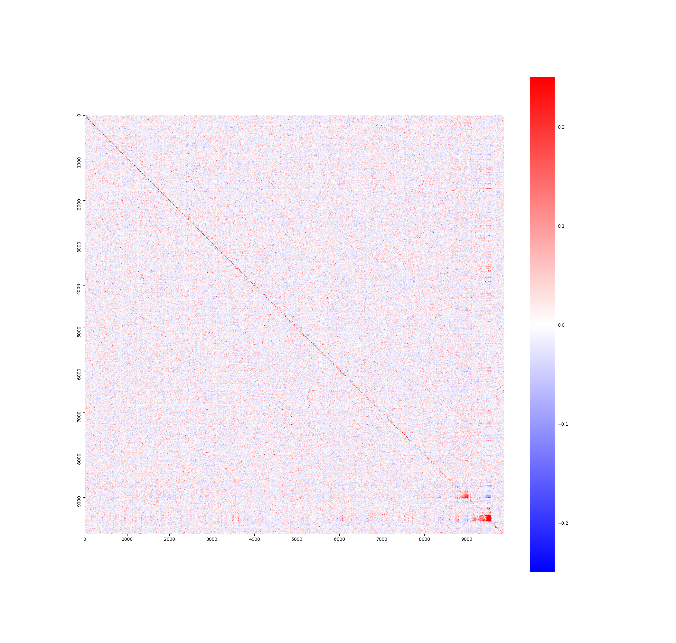

Contamination effect on gene correlation
B cell
Contaminated
Decontaminated

Slide 22
Summary
Intra- and inter-cellular UMI contamination can be eliminated by frequency.
Contamination have significant effect on gene correlation, by increasing gene expression level in other cells and resulting in many high positive or negative correlation.

Slide 23
Acknowledgement
Thank Wenping Ma for MALBAC-DT experiment.
Thank Feng Tian for data preprocessing.
Thank Wenting Cai for discussion.
Thank all members in GeACT.

